Slide 1
National Science Bowl Club
Welcome!
Please sign in…

Slide 2
National Science Bowl Competition:
Buzzer-based group science competition sponsored by the Department of Energy
Teams typically consist of 5 players, with 4 playing at a time and 1 as an alternate.
Teams must win the regional competition to advance to nationals.
Rules and practice questions are available here:
http://science.energy.gov/wdts/nsb/high-school/high-school-students/

Slide 3
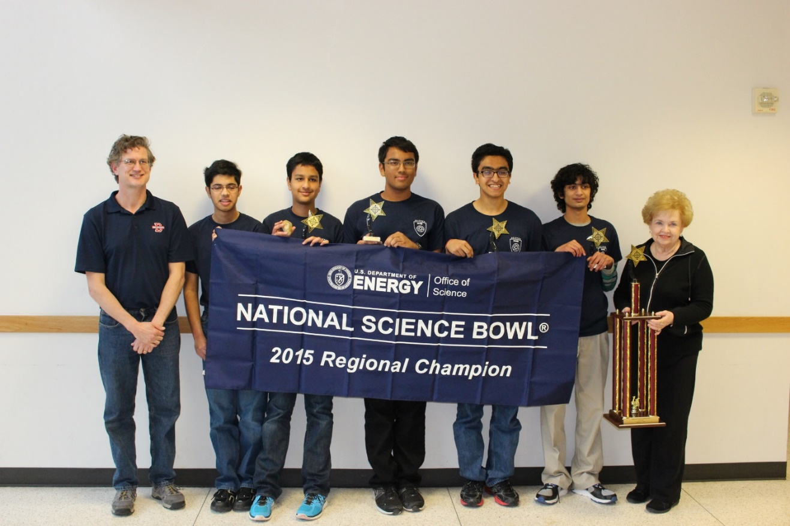
Why a NSB Club?
DHS NSB team has won the regional championship for the past three years.
We have placed 12th and 7th in the nation.
We have gained lots of experience from these competitions and we want to share it for greater success in the future.

Slide 4
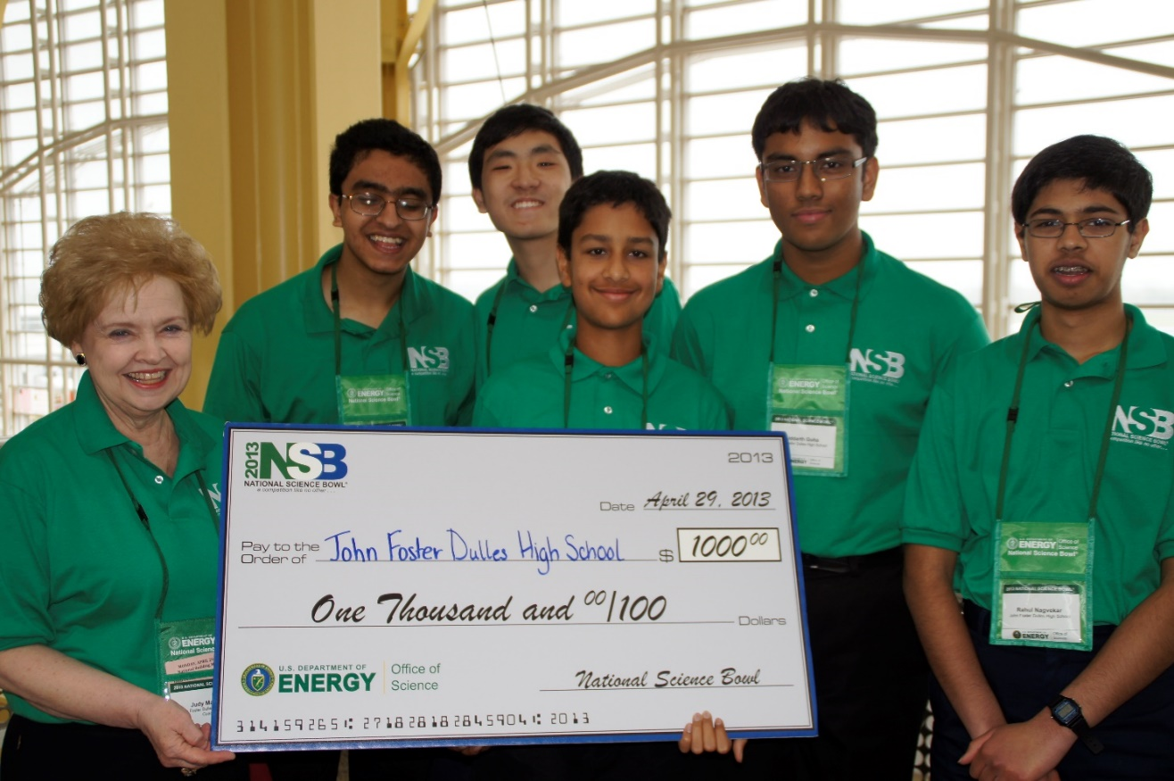
NSB Club Goals and Mission
To use experience from science bowl competitions to create a framework for continued success for Dulles High School Science Bowl teams.
To increase skill level and interest in this competition and in the sciences.
To collect resources and teaching materials to train interested individuals.
To advertise and increase member participation.

Slide 5
NSB Club Officers:
Sponsor: Ms. Judy Matney
Founder and President: Aman Patel
Vice Presidents: Brian Bell and Vishnu Iyer
Secretary: Rahul Nagvekar
Treasurers: Benjamin Liu and Shreya Thipireddy
Historian: Shreyas Balaji

Slide 6
Who Can Join
The club is open to any high school student who would like to participate in this competition and learn more about science.

Slide 7
Membership Expectations
Familiarize yourself with the NSB rules prior to the first meeting day
Independently practice with sample questions on the DOE website
Comply with NSB club membership dues in a timely manner
Engage in science-related reading and studying on your own time
Regularly attend NSB club meetings and participate in club competitions
Practice independently with your team

Slide 8
Meeting Information
First meeting: Thursday, September 10
The meetings are on the 2nd, 3rd, and 4th Thursdays of each month, with the exception of holidays and early dismissals.
Extra practice dates maybe announced, if necessary.
We will practice from September to January. The regional competition is in February.

Slide 9
Teams
You will have the option of either forming your own team or having us place you in a team.
  This will be done by using the responses of a Google form all members are required to fill out.
We recommend joining a team which you complement and bring a unique skillset to.

Slide 10
Membership Dues
Everyone must make 5 toss-up and 5 bonus questions, each from a different category, for every meeting.
If a member is late in turning in questions, he/she will have to turn in double the amount missed plus the regular amount for the next week.
The team who wins the competition during a meeting will be able to turn in 3 questions at the next meeting instead of 5.

Slide 11
General Information
Interested members, please sign up here: www.tinyurl.com/NSBmember2015
We would love for parents to help out and volunteer.

Slide 12
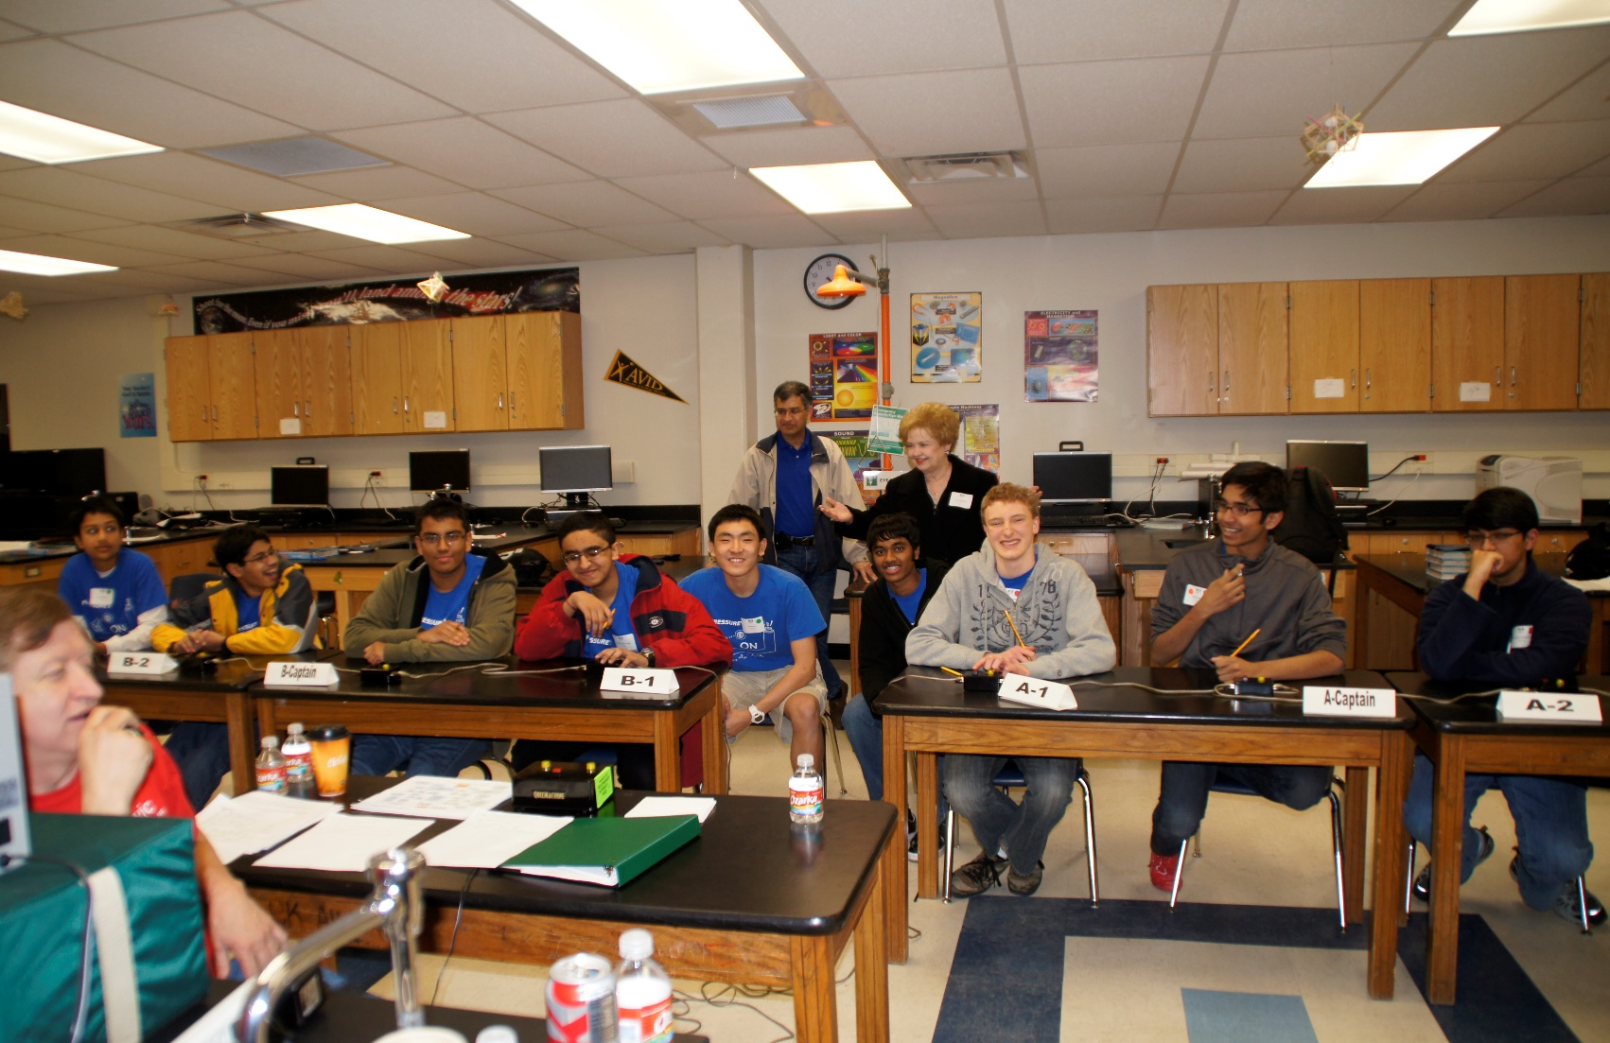
Join the NSB Club!

